Slide 1

NotesHub: Your Personalized Student Notes Platform

Slide 2



Secure & Personalized Access
NotesHub ensures your learning journey is both secure and highly customized. Our robust login system is designed to provide seamless access while protecting your valuable academic data.
Identity Verification
Year-Specific Content
Data Privacy & Security
Students authenticate with their unique Username and Password, establishing a secure personal profile on the platform.
Inputting your Academic Year dynamically tailors notes to your specific curriculum and current study level.
Advanced encryption and secure protocols safeguard your academic materials and personal information at all times.

Slide 3

Tailored Notes for Focused Learning
NotesHub revolutionizes how students access educational materials. Our platform intelligently curates and delivers content directly aligned with your academic progression, ensuring maximum relevance and study efficiency.
01
02
Dynamic Content Delivery
Comprehensive Subject Coverage
Access notes precisely matched to your current academic year, eliminating irrelevant or outdated information.
Explore a wide array of subjects and formats, including text, diagrams, and multimedia, regularly updated by educators.
03
Optimized Learning Paths
Benefit from organized, high-quality materials designed to streamline your study process and enhance comprehension.

Slide 4
Study Anytime, Anywhere: Offline Access
Never let an internet connection limit your learning. NotesHub empowers you to download your essential study materials, ensuring uninterrupted access across all your devices, even in remote locations.
Download & Save
Multi-Device Compatibility
Uninterrupted Learning
Securely download all your notes directly to your preferred device for convenient and reliable offline access.
Your notes are effortlessly accessible on laptops, tablets, and smartphones, adapting seamlessly to your study method.
Continue your studies in any environment, whether during travel or in areas without network coverage, free from internet dependency.

Slide 5
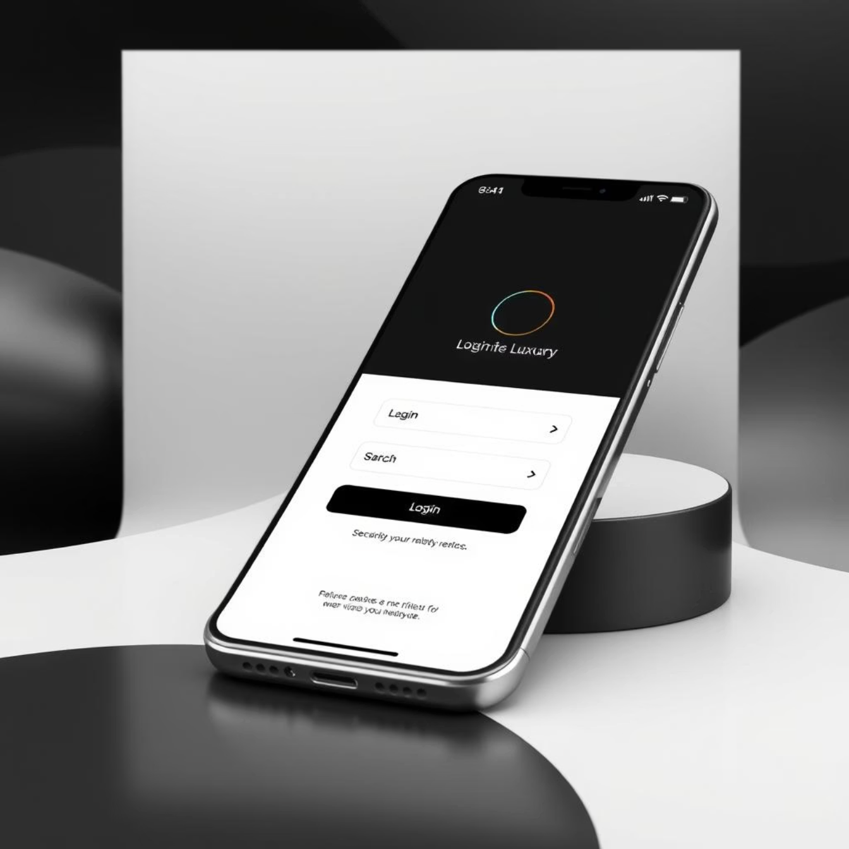
Intuitive Design & Powerful Features
NotesHub is crafted for simplicity and efficiency, providing a seamless user experience from login to advanced note management. Our interface is clean, modern, and easy to navigate, ensuring you spend less time searching and more time learning effectively.
Streamlined Dashboard
Smart Search & Organization
Effortlessly browse and select notes organized by subject, course, and academic year from an intuitive overview.
Utilize powerful search functions and personal tagging to quickly find and group your study materials with ease.
Bookmark Key Insights
Mark important sections for quick reference, allowing you to create a personalized, efficient learning roadmap.
A clean and straightforward login experience ensures quick and secure access to your personalized academic content.

Slide 6

Empower Your Academic Journey
NotesHub is more than just a note-sharing platform; it's your dedicated partner in achieving academic excellence. We combine personalization, security, and accessibility to transform and enhance your study habits.
Personalized Learning
Secure & Reliable
Access tailored content that precisely aligns with your academic year and curriculum needs.
Study with complete confidence, knowing your data and notes are protected by robust security measures.
Accessible Anywhere
Download notes for seamless offline access, ensuring your studies are never interrupted, wherever you are.
Join NotesHub today and unlock your full academic potential!

